Slide 1
Hydrogen electolyser

Slide 2
Porous metal (Metal Foam) as a flow field in BPP
Conventional graphite materials are used as BPP materials due to their good electrical conductivity and corrosion resistance. However, they also have inherent shortcomings: high manufacturing cost, poor mechanical property, and low power density.
Compared with conventional graphite BPPs, metal BPPs exhibit the advantages of excellent manufacturability, higher mechanical strength, and lower cost. This has proven to be an effective solution to replace the conventional graphite BPPs of PEM Electrolyser. Porous metal materials show many advantages in pore distribution, porosity, permeability, specific surface area, capillary properties, etc. Based on these excellent properties, they have been widely used in flow distribution, heat transfer, and catalyst support, and their application in PEM Electrolyser is mainly in the form of metal foam. The main materials studied extensively for metallic BPPs are titanium, nickel, aluminum, and copper.

Slide 3
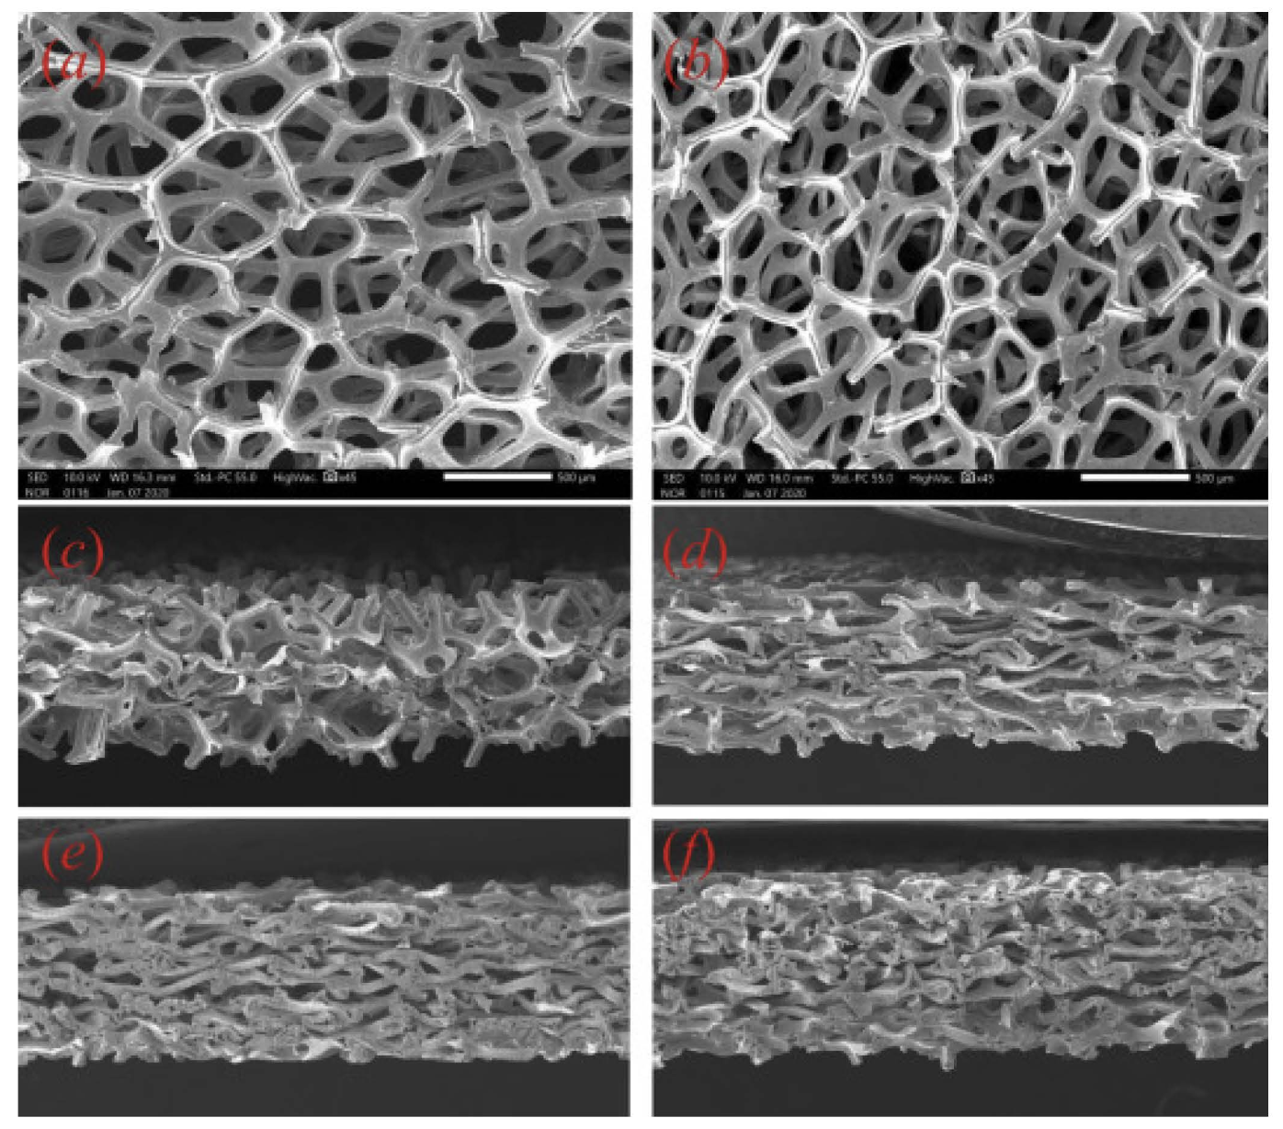
SEM IMAGES
(a) the top view of the nickel foam, (b) the top view of the compressed nickel foam, (c) the cross-section of the compressed nickel foam (1.5 mm), (d) the cross-section of the compressed nickel foam (2.0 mm), (e) the cross-section of the compressed nickel foam (2.5 mm), and (f) the cross-section of the compressed nickel foam (3.0 mm).

Slide 4
Challenges faced while using Metal BPPs
Metal BPPs prone to corrosion during fuel cell operation: Metal bipolar plates (BPPs) in fuel cells face corrosion issues because they operate in acidic, high-temperature (343K), and oxygen-rich conditions. Corrosion degrades the metal, increases electrical resistance (due to oxide layer formation), and releases harmful metal ions that can damage catalysts.
Oxide film formation increases Interface Contact Resistance (ICR): The corrosion caused oxide films to form and these oxide films are generally non-conductive or only slightly conductive compared to the metal underneath. As a result, they hinder electron flow across the interface.This increases the contact resistance at the interface, which in turn:
Reduces the overall conductivity of the fuel cell stack. Leads to performance losses (less efficient electron transfer). Causes higher ohmic losses and heat generation.

Slide 5
Solutions to the faced challenges
To avoid corrosion protective coatings are essential for metal bipolar plates in Electrolysers to address corrosion and increase interface conductivity. Techniques like spraying, cyclic voltammetry, and constant current methods are used to apply these coatings. Studies have shown that doping coatings with elements like aluminum and using advanced deposition methods such as pulsed DC sputtering improve both corrosion resistance and conductivity. However, testing the long-term durability of these coatings is expensive and time-consuming, so researchers have developed life prediction models to estimate their lifespan more efficiently, helping to ensure reliable and cost-effective performance.[Reference]
Challenges | Solutions
Rupture | Molding process improvement
Corrosion | Anti-corrosion coating
Oxide film | Conductive film

Slide 6
Comparison between channel and metal flow fields
Aspect | Conventional Channel-Rib Flow Field | Metal Foam Flow Field
Design Structure | Channels separated by solid ribs Typically machined or molded Fixed geometry flow paths | Porous structure with interconnected pores Open and random flow paths Formed from metal foams (nickel, titanium, etc.)
Flow Distribution | Flow follows predefined channels Uneven distribution, risk of dead zones at low flow rates | 3D porous structure allows more uniform distribution Reduced risk of dead zones Better contact with GDL
Concentration Loss | More prone to concentration losses at high current densities Local depletion of reactants | Improved mass transport reduces concentration losses Enhanced reactant supply at high current densities

Slide 7
Aspect | Conventional Channel-Rib Flow Field | Metal Foam Flow Field
Ohmic Losses | Lower through-plane electrical conductivity in channel areas Limited GDL/flow field contact area | Improved electrical pathways due to large contact area Lower ohmic losses at GDL/metal foam interface
Pressure Drop | Generally lower due to defined channel geometry | Higher pressure drop due to complex porous structure
Thermal Management | Limited heat transfer through ribs and channels Risk of local hot spots | Enhanced heat transfer through 3D foam network More uniform temperature distribution
Durability | Less prone to corrosion if graphite used | Metal foams need corrosion-resistant coatings.Surface treatments improve durability

Slide 8
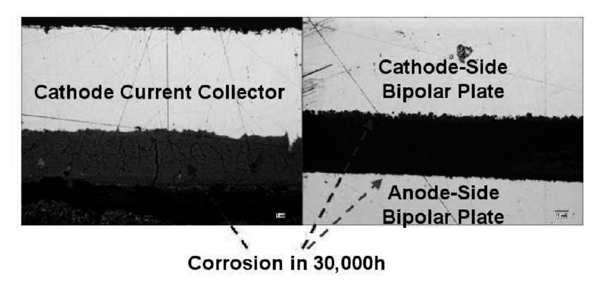
Materials for BPPs
We an use either Titanium or Stainless Steel. Titanium is the material mostly used for BPPs because it's strong and doesn't corrode easily. However, it's very expensive. Stainless steel is much cheaper but corrodes quickly in the acidic and high-voltage environment inside the electrolyzer.
When corrosion happens, metal particles can leak into the system and ruin the performance by poisoning the membrane and catalyst.

Slide 9
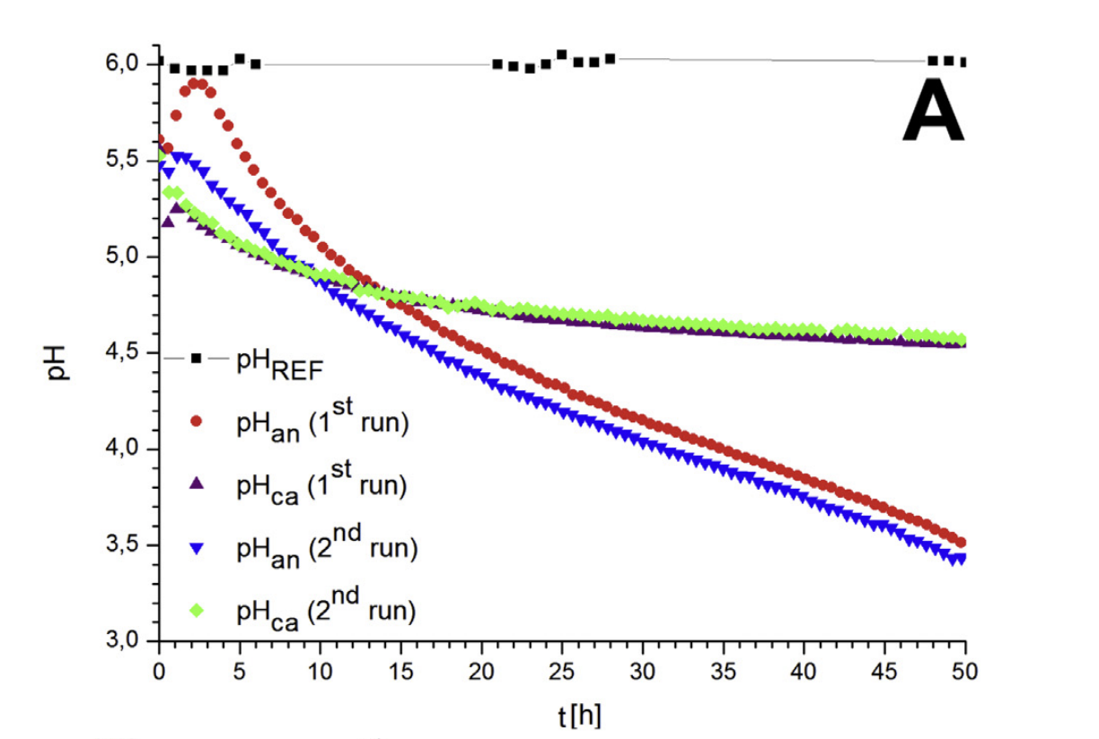
Corrosion due to decrease in pH of the solution
According to the readings it is noticeable in the figure that the anode side has a steeper reduction in pH over time than the cathode side. This could mean a higher proton entry rate on the anode side. At the end of the 50 h run, the pH value of the anode side reached a value of 3.5 and the cathode a value of near 4.5. This shows that anode is more prone to corrosion than cathode.

Slide 10
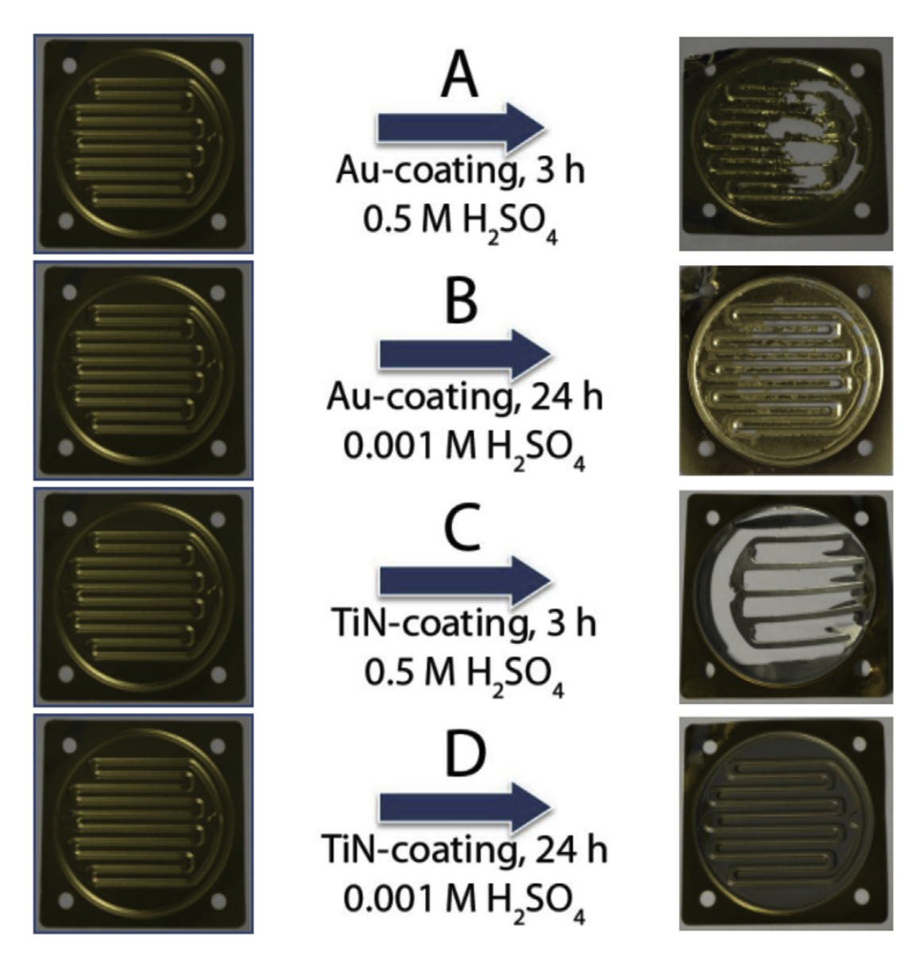
Testing of different coatings for BPPs
The testing was done at a constant potential of 2.00 V in 0.5 mol/L sulfuric acid during 3 and 24 h.
The used coatings are Au and TiN, which were coated by PVD technique with a deposit thickness of 0.2 (Au) and 0.5 (TiN) mm.
The exposure to the milder corrosion media (0.001 mol/L H2SO4) is responsible for attacking only the coated layers, and the substrate materials remain stable throughout the duration of the test

Slide 11
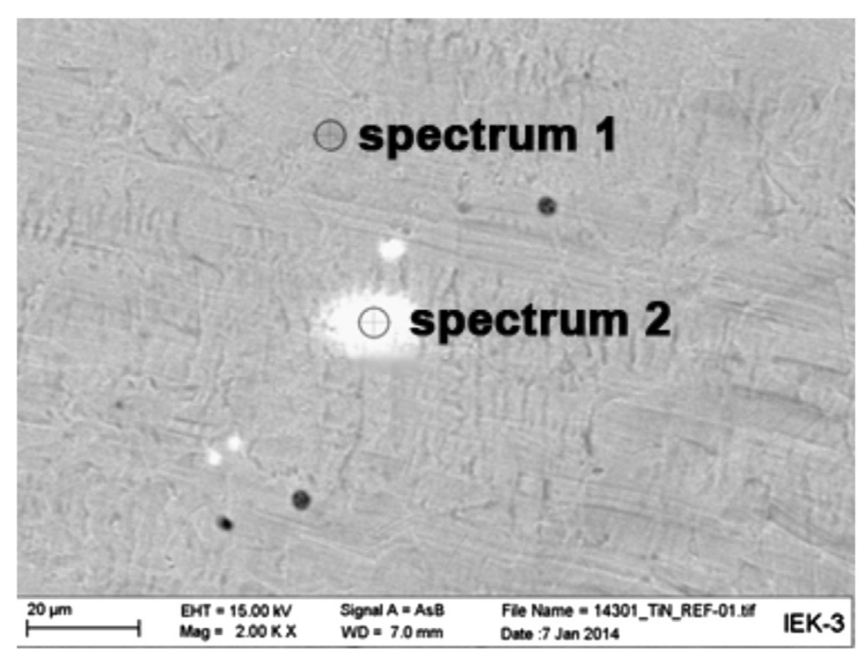
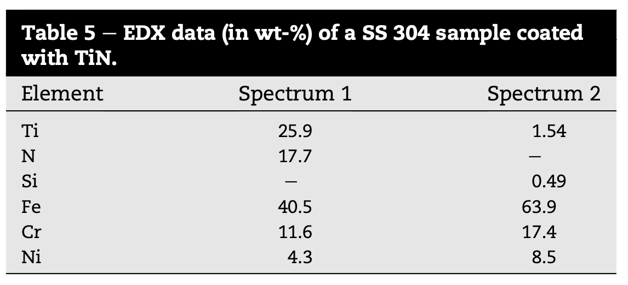
Pinholes in Protective Coatings
In the initial surface analysis of untreated Au and TiN coated samples by SEM it was determined, that small areas on the surface were not fully coated, resulting in pin-holes in the coating. The SEM micrograph of TiN coated SS 304 is visible in Fig. 6 and the corresponding values of the EDX spectra 1 and 2 are shown in Table 5. Looking at the values in Table 5 it is clear that at the position of spectrum 2 very little Ti and no N could be determined. This is an indication of defective spots in the TiN layer. The corrosion media undercut these pits and directly attack the substrate material. Due to the instability of stainless steels to high acid concentrations the substrate material as a result is dissolved by the corrosion media.
Fig: SEM micrograph of an untreated SS 304 coated with TiN
Table: EDX data of a SS 304 sample coated with TiN.

Slide 12
Surface Treatments to be done
To modify the surface of metal to resist corrosion and maintain conductivity we use surface treatments like:
Chromizing:
Creates a Cr-rich layer.
Effective barrier against acidic corrosion.
Nitriding/Carburizing:
Forms hard surface layers like CrN.
Enhances durability and conductivity.
Electrochemical treatments:
Improve passive oxide layer properties.
Increase corrosion potential and lower corrosion current.

Slide 13
Different coatings that can be done
Coating Type | Advantages | Concerns
TiN | Reduces corrosion current, strong layer | May have pinholes, delaminates over time
CrN | Excellent barrier, better contact resistance | Needs uniform application
Amorphous Carbon | Highly stable, low corrosion current | More costly process
Conductive Polymers | Good short-term resistance, simple method | Degrades over time, not long-lasting

Slide 14
Why are we using Titanium?
Grade 2 titanium is chosen for electrolyzer parts (electrodes, tanks) because:
It has high corrosion resistance (forms a stable oxide film).
It’s strong and durable.
However, titanium is expensive and can suffer damage from hydrogen embrittlement and acid corrosion, especially in harsh condition

